Slide 1


AtliQ’s Consumers Goods Domain
MySQL Project Challenge (RPC-4) Codebasics Challenge 4
By Shubham Sakpal

Slide 2
About AtliQ and the Problem Statement
Atliq Hardwares (imaginary company) is one of the leading computer hardware producers in India and well expanded in other countries too.
However, the management noticed that they do not get enough insights to make quick and smart data-informed decisions.
There are total of 10 ad-hoc request/problem statements by Atliq Hardware for which they want insights.

Slide 3
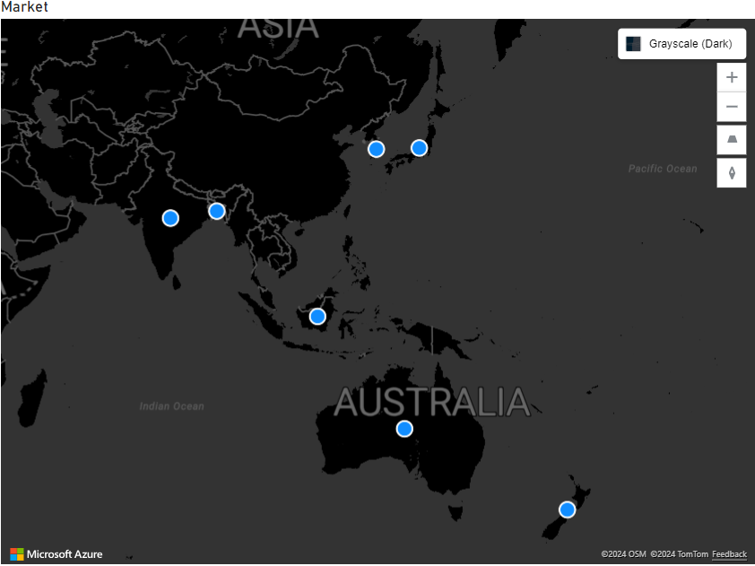

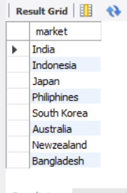
1. List of markets in which customer "Atliq Exclusive" operates its business in the APAC region.
Insights – India, Indonesia, Japan, Philippines, South Korea, Australia, New Zealand, and Bangladesh are markets where Atliq Exclusive operates in the APAC region.
Map View
MySQL Query
Query Result

Slide 4
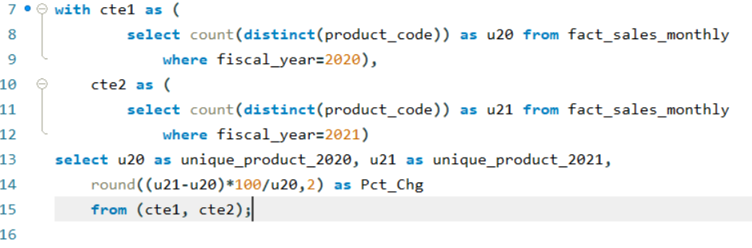

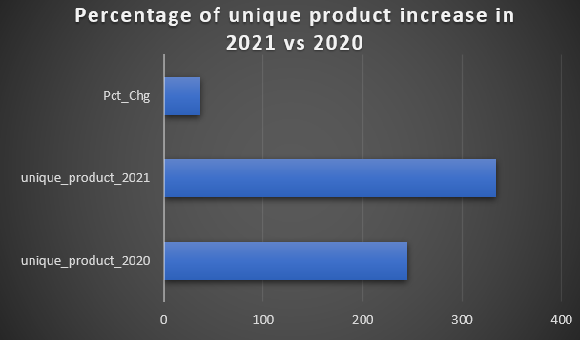
2. Percentage of unique product increase in 2021 vs. 2020.
MySQL Query
Result
Column View
Insights There was a 36.33% increase in the unique product count in 2021 compared to 2020.

Slide 5
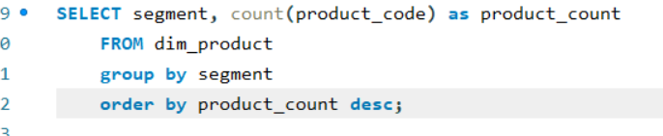
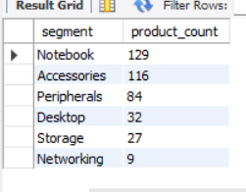
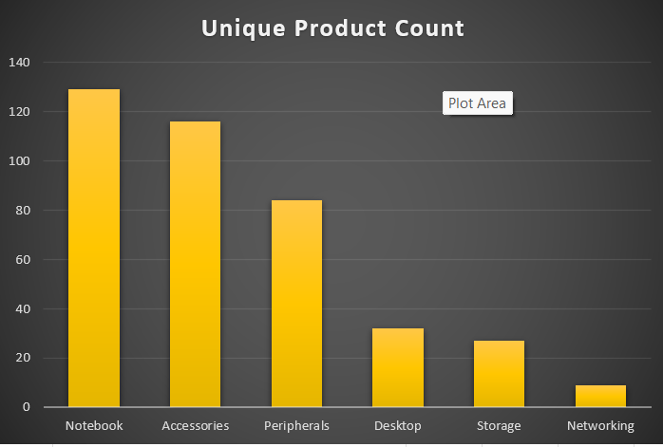
3. All the unique product counts for each segment.
Result
MySQL Query
Column View
Insights Atliq needs to improve its unique product in the Networking, Storage, and Desktop segment.

Slide 6
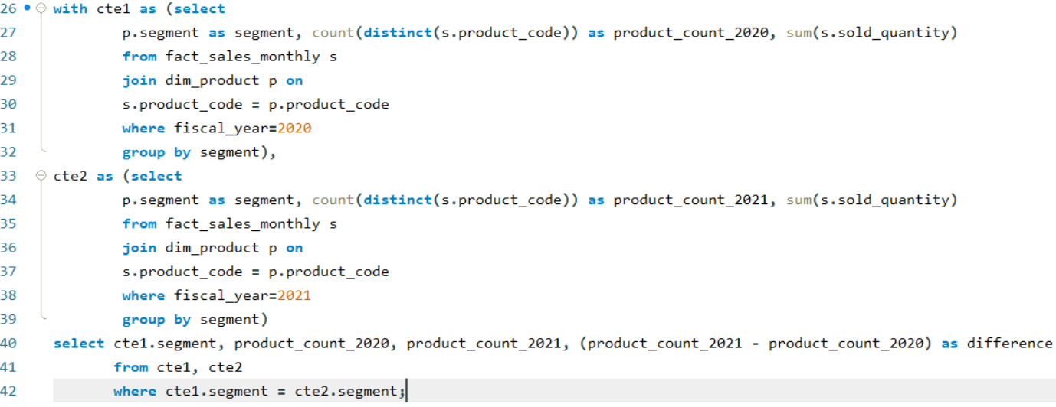
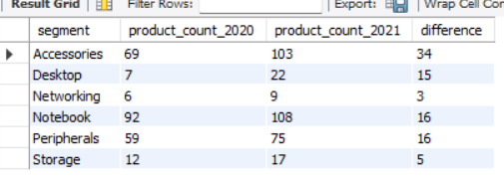
4. Segment had the most increase in unique products in 2021 vs 2020
MySQL Query
Result

Slide 7
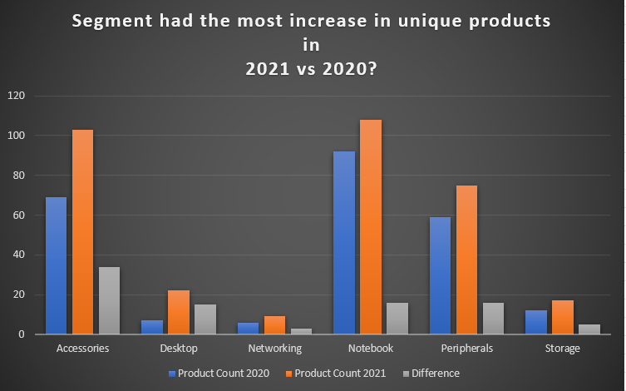
Column View
Insights The Accessories Segment had the most increase in unique products in 2021 with a unique product count of 34 and the least increase in Networking with a unique product count of 3

Slide 8
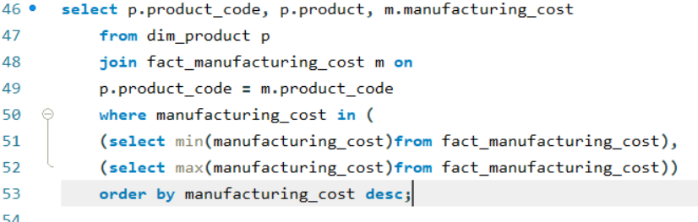
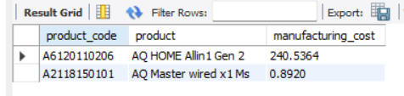
5. Products that have the highest and lowest manufacturing costs.
MySQL Query
Result
Insights The highest manufacturing cost is 240.53 for AQ HOME Allin1 Gen 2 and the lowest is 0.892 for AQ Master wired x1 Ms.

Slide 9
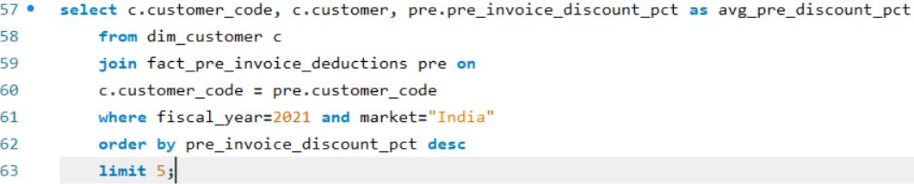
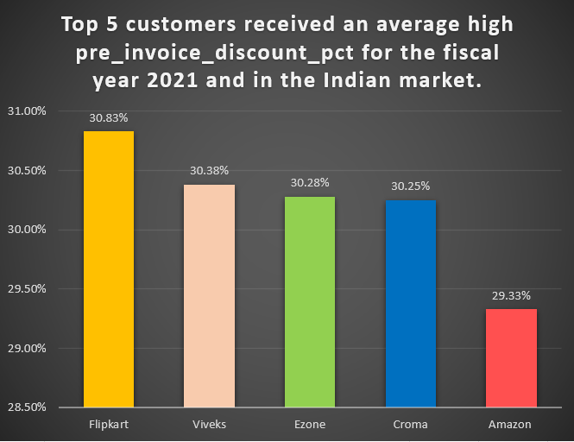
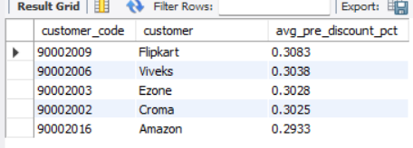
6. Top 5 customers received an average high Pre Invoice Discount Percentage for the fiscal year 2021 and in the Indian market.
Insights Flipkart followed by Viveks, Ezone, Croma, and Amazon were the top 5 customers to receive high Pre Invoice Discount Percentage.
MySQL Query
Column View
Result

Slide 10
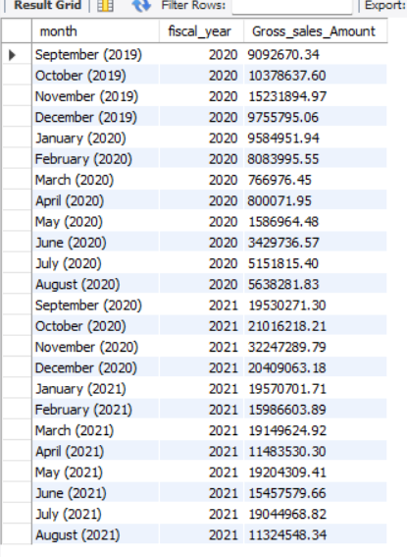
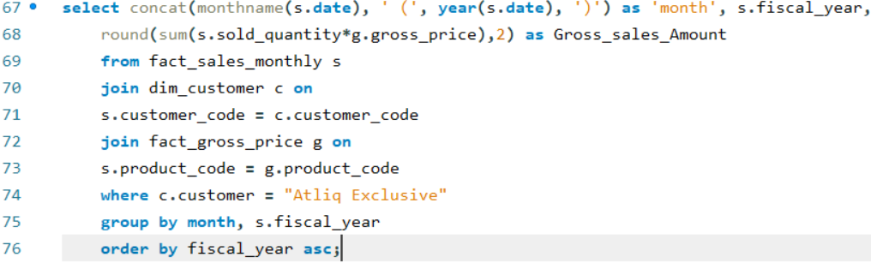
7. Complete report of the Gross sales amount for the customer “Atliq Exclusive” for each month.
Result
MySQL Query

Slide 11
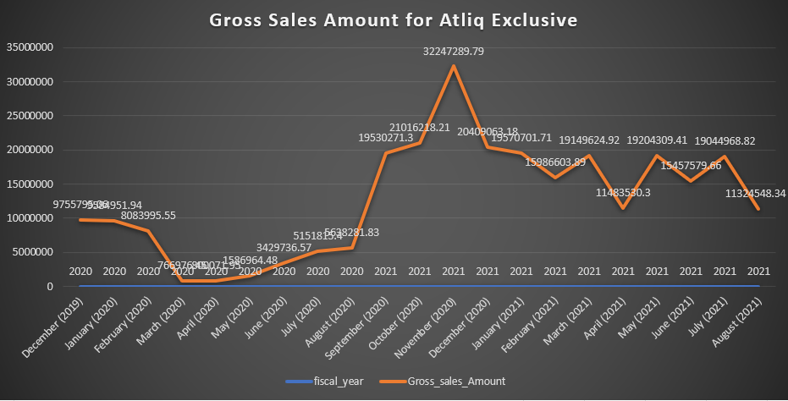
Insights 1. The Average Gross Sales Amount for Atliq Exclusive from Dec(2019) to Aug(2021) is 16.51 Million $ 2. The Highest Gross Sales Amount generated was in Nov(2020) which is 32.25 Million $ 3. Lowest Gross Sales Amount generated was in March(2020) which is 0.77 Million $ 4. Gross Sales after August(2020) till date received a massive increase and surpassed the Average gross sales amount.
Line Chart

Slide 12
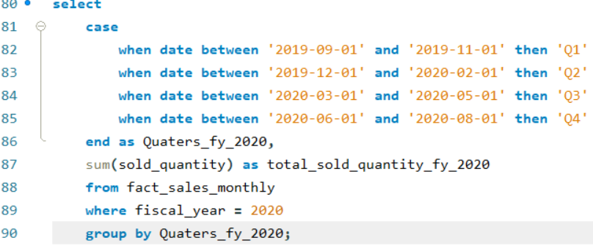
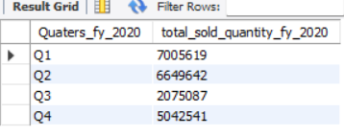
8. In which quarter of 2020, got the maximum Total Sold Quantity?
MySQL Query
Result

Slide 13
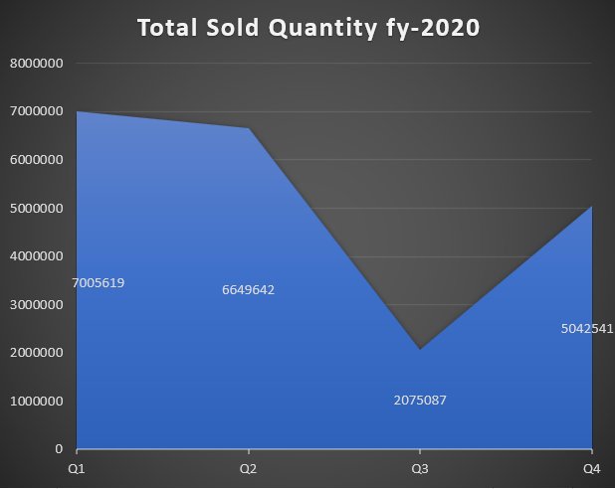
Sold Quantity Quarter-wise
Insights 1. Sales for Q1(Sept, Oct, Nov) received the highest which is 7 million $. 2. Sales for Q3(March, April, May) received the lowest which is 2.07 million $. 3. Reason for Q3’s low performance was due to Covid-19.

Slide 14
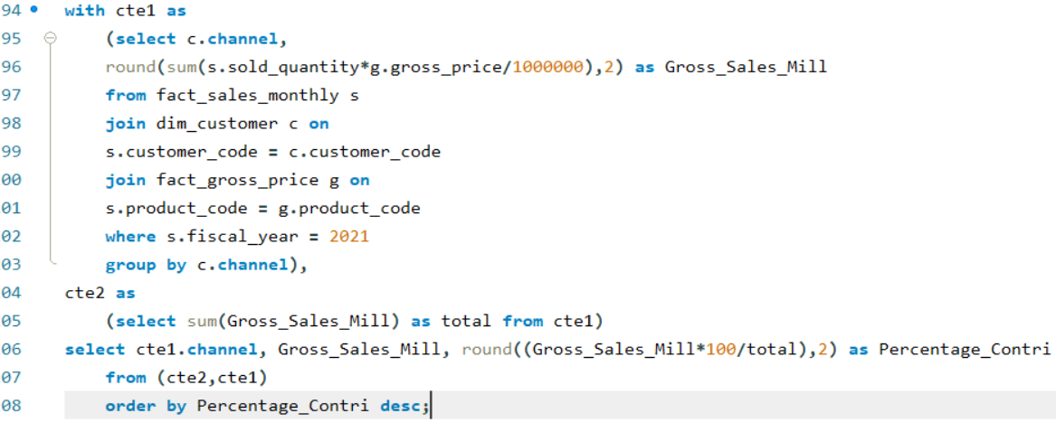
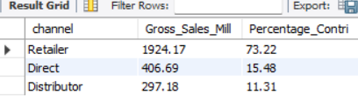
9. Channel helped to bring more gross sales in the fiscal year 2021 and the percentage of contribution.
MySQL Query
Result

Slide 15
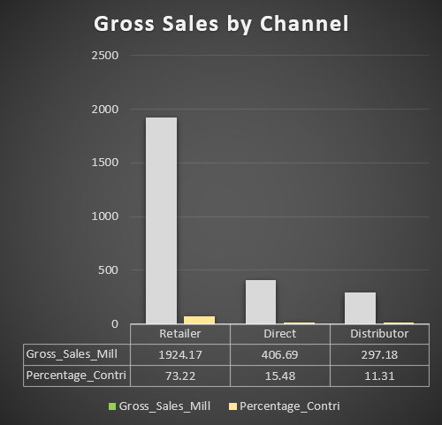
Column View
Insights We saw the highest gross sales(73.22%) from retailers and the lowest (11.31%) through distributors. Atliq Hardware should increase its product sales in direct & distributor channels.

Slide 16
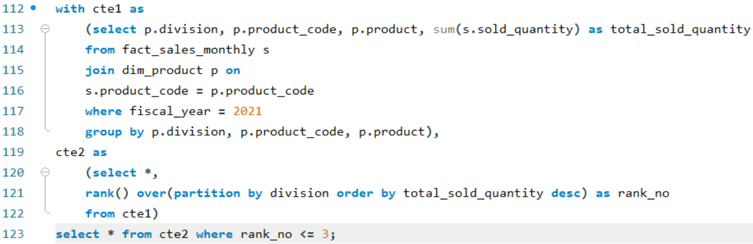
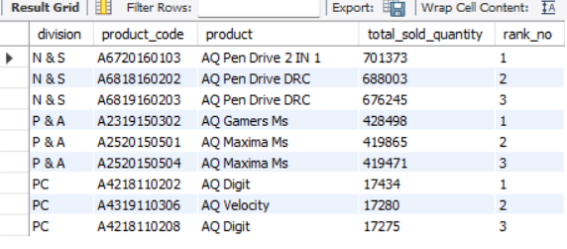
10. Top 3 products in each division that have a high total sold quantity in the fiscal year 2021
MySQL Query
Result

Slide 17
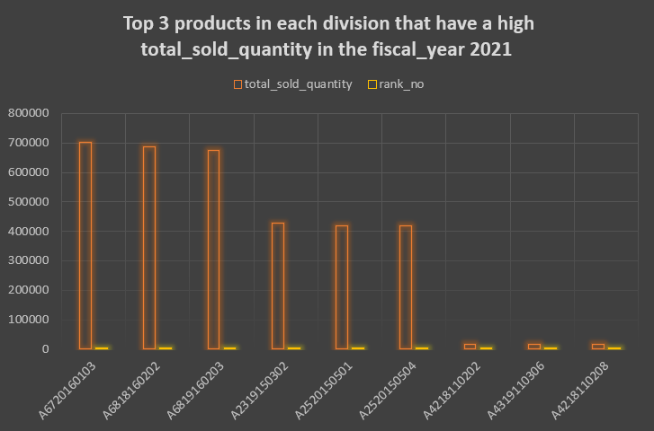
Column View
N & S Division
P & A Division
PC Division

Slide 18
Insights 1. Considering the volume of total sold quantity ‘N & S Division’ has the highest performance(2 million total sold quantity) while ‘PC Division’ has the lowest total sold quantity(52k). 2. The PC Division has one of the highest revenues per product, so increasing its sold quantity will increase the overall gross sales amount for Atliq Hardware.

Slide 19
END Thank You

